Slide 1
Lex/flex and yacc/bison

Slide 2
Flex and Bison are tools for building programs that handle structured input.
They were originally tools for building compilers, but they have proven to be useful in many other areas.

Slide 3
Flex(Lex)
A flex program basically consists of a list of regexps with instructions about what to do when the input matches any of them, known as actions.
A flex-generated scanner reads through its input, matching the input against all of the regexps and doing the appropriate action on each match.
Flex translates all of the regexps into an efficient internal form(DFA) that lets it match the input against all the patterns simultaneously,

Slide 4
The general format of flex source is:
……..definitions section
%%
……..rules section
%%
………user subroutines

Slide 5
Flex program consists of three sections, separated by %% lines.
The first section contains declarations and option settings.
The second section is a list of patterns (regexps) and actions.
and the third section is C code that is copied to the generated scanner, usually small routines related to the code in the actions.

Slide 6
In the declaration section, code inside of %{ and %} is copied through verbatim near the beginning of the generated C source file.
In the second section, each pattern is at the beginning of a line, followed by the C code to execute when the pattern matches.
The C code can be one statement or possibly a multiline block in braces, { }.
Each pattern must start at the beginning of the line, since flex considers any line that starts with whitespace to be code to be copied into the generated C program.

Slide 7
yylex(), the name that flex gives to the scanner routine.
In the absence of any other arrangements, the scanner reads from the standard input.
Commands to create the scanner
$ flex file.l
$ cc lex.yy.c -lfl
$ ./a.out

Slide 8
Tie –breaking in Flex
Prefer the pattern that matches longer lexeme.
and if two patterns match the same lexeme, it prefers the pattern that appears first in the flex program.

Slide 9
The Scanner as Coroutine (yylex())
Each time a program (like parser)needs a token, it calls yylex(), which reads input stream and returns the token. When it needs another token, it calls yylex() again.
The scanner acts as a co-routine; that is, each time it returns, it remembers where it was, and on the next call it picks up where it left off.

Slide 10
if a pattern doesn’t produce a token for the calling program and doesn’t return, the scanner will just keep going within the same call to yylex(), scanning the next input characters.
Each token actually has two parts, the token and the token’s value.
The token is a small integer. The token numbers are arbitrary, except that token zero always means end-of-file.

Slide 11
When yacc/bison creates a parser, bison assigns the token numbers automatically starting at 258 (this avoids collisions with literal character tokens, discussed later) and creates a .h with definitions of the tokens numbers.

Slide 12
Flex-Bison Environment Variables
yytext :the variable yytext is set to point to the input text that the pattern just matched i.e. current lexeme.
yylval : contains attribute value of current token, default value is Integer, but can be changed.
yyleng: length of lexeme found.
yyin: input stream , default is keyboard
FILE *yyin
yyout: output stream , default is monitor.
FILE *yyout

Slide 13
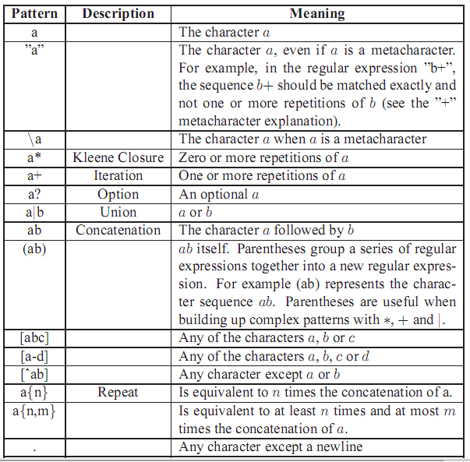

Slide 14
Lex/Flex examples- Counting lines/words/characters
%option noyywrap
%{
int lines=0, words=0, characters=0;
%}
%%
\n {lines++; characters++};
[^ \t\n]+ {words++; characters+=yyleng;}
. {characters++;}
%%
main() {
yylex();
printf(“%d\t%d\d%d\n”, characters, words, lines);
return(0);
}

Slide 15
Lex/Flex examples- Adding lines to source code
%option noyywrap
%{
int lineno=1;
%}
Line [^\n]+\n
%%
{Line} { printf("%d %s", lineno++, yytext); }
%%
main() {
yylex();
}

Slide 16
Regular definitions
Name Regular expression
Using defined name in another RE:
{Name}
Ex:
delim [ \t\n]
ws {delim}+

Slide 17
ECHO
- the macro ECHO writes the token to the current output
The default action in flex for input text that doesn’t match any pattern is to write the text to the output, equivalent to ECHO.
In flex, %option nodefault or the command-line flag -s or --nodefault makes the default action abort,

Slide 18
Start conditions/states/rules
Sometimes it is desirable to have several sets of lexical rules to be applied at different times in the input.
For example, a compiler preprocessor might distinguish preprocessor statements and analyze them differently from ordinary statements.
- This requires sensitivity to prior context, and there are several ways of handling such problems.

Slide 19
Using ﬂags: user’s resoposibilty.
Using start condition: Lex/Flex ‘s reponsibility.
Consider the following problem: copy the input to the output, changing the word magic to first on every line which began with the letter a, changing magic to second on every line which began with the letter b, and changing magic to third on every line which began with the letter c. All other words and all other lines are left unchanged.

Slide 20
%option noyywrap
int flag;
%%
^a {flag='a'; ECHO;}
^b {flag='b'; ECHO;}
^c {flag='c'; ECHO;}
\n {flag=0; ECHO;}
magic { switch(flag)
{ case 'a': printf("First"); break;
case 'b': printf("Second"); break;
case 'c': printf("Third"); break;
default: ECHO; break;
}
}
%%
main(){
yylex();
}

Slide 21
To handle the same problem with start conditions, each start condition must be introduced to Lex in the deﬁnitions section with a line reading
%Start name1 name2 ...
%x name1 name2 …
where the conditions may be named in any order.
The word %Start (may be abbreviated to %s or %S) create inclusive start conditions and %x or %X create exclusive start conditions.
The conditions may be referenced at the head of a rule with the < > brackets:
<name1>RegularExpression
is a rule which is only recognized when Lex is in the start condition name1.

Slide 22
-To enter a start condition, execute the action statement
BEGIN name1;
which changes the start condition to name1.
-To resume the normal state,
BEGIN 0;
resets the initial condition of the Lex automaton interpreter.
- A rule may be active in several start conditions:
<name1,name2,name3>RegularExpression
is a legal preﬁx.
- When Flex is in one of the inclusive start conditios, rules not beginning with the <> preﬁx operator remains always active.

Slide 23
%option noyywrap
%s AA BB CC
%%
^a {ECHO; BEGIN AA;}
^b {ECHO; BEGIN BB;}
^c {ECHO; BEGIN CC;}
\n {ECHO; BEGIN 0;}
<AA>magic {printf("First"); }
<BB>magic {printf("Second"); }
<CC>magic {printf("Third"); }
%%
main(){
yylex();
}
NOTE: unmatched inputs are copied to output.

Slide 24
%x COMMENT
%%
"/*" { BEGIN COMMENT; /* switch to comment mode */ }
<COMMENT>. |
<COMMENT>\n ; /* throw away comment text */
<COMMENT>"*/" { BEGIN INITIAL; /* return to regular mode */ }
Notes:
unput(c)

Slide 25
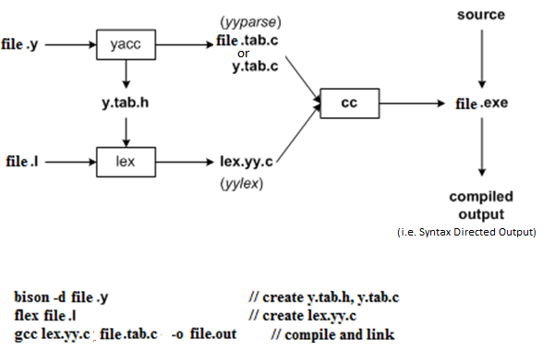
Bison with Flex (one possible method)

Slide 26
Yacc/Bison reads the grammar descriptions in input file.y and generates a syntax analyzer (parser), that includes function yyparse, in output file file.tab.c.
The -d option causes yacc/bison to generate definitions for tokens and place them in file file.tab.h if token are declared in file.y file.
Lex/flex reads the pattern descriptions in input file.l, includes file file.tab.h, and generates a lexical analyzer, function yylex, in output file lex.yy.c.
Finally, the lexer and parser are compiled and linked together to create executable file file.out(or file.exe).
From main function we call yyparse () to run the parser.
Function yyparse ()automatically calls yylex() to obtain next token.

Slide 27
The general format of bison source is same as for flex file:
……..definitions section
%%
……..rules section
%%
………user subroutines

Slide 28
Definitions section
There are three things that can go in the definitions section:
C code :Any code between %{ and %} is copied to the C file. This is typically used for defining file variables, and for prototypes of routines that are defined in the code segment.
Token definitions: this option used for token declarations(Non-ASCII) .By convention, tokens have uppercase names, although bison doesn’t require it. These token definitions are written to a heaser (dot).h file when yacc compiles this file.
Associativity rules :These handle associativity and priority of operators

Slide 29
Definitions section
Ex:
%{
#include<stdio.h>
int v1;
%}
%token NUM ID
%left '+' '-'
%left '*' '/'

Slide 30
Any symbols not declared as tokens have to appear on the left side of at least one rule in the program to become a non-terminal. (If a symbol neither is a token nor appears on the left side of a rule, it’s like an unreferenced variable in a C program.)

Slide 31
Rules section
The second section contains the rules (production rule of CFG) in simplified BNF.
Bison uses a single colon(:) rather than ::= or →, and since line boundaries are not significant, a semicolon marks the end of a rule.
Again, like flex, the C action code goes in braces at the end of each rule.

Slide 32
Rules section
expn : expn '+' expn {$$= $1 + $3;}
| expn '-' expn {$$= $1 - $3;}
| expn '*' expn {$$= $1 * $3;}
| expn '/' expn {$$= $1 / $3;}
| '(' expn ')' {$$=$2;}
| NUMBER
| ID {$$=SymTable[$1];}
;
Notes:
For grammar:
E-> E+E | E-E | E*E | E/E | num | id

Slide 33
It is assumed that each symbol in a bison rule has an associated value (of type int until specified otherwise).
The associated value of the target symbol (the one to the left of the colon) is called $$ in the action code, and the values on the right are numbered $1, $2, and so forth, up to the number of symbols in the rule.
The values of tokens are whatever was in yylval when the scanner returned the token.
the values of other symbols(NonTerminal) are set in rules in the parser.
In the absence of an explicit action on a rule, the parser assigns $1 to $$.

Slide 34
we include a header file (file.tab.h) in flex program that bison will create for us, which includes definitions of the token numbers as (constant) and a definition of yylval.
Whenever bison reduces a rule, it executes user code(actions) associated with the rule.

Slide 35
If a grammar is ambiguous, bison reports conflicts, places where there are two different possible parses for a given bit of input.
It creates a parser anyway, picking one option in each conflict, but that choice means the language it’s parsing isn’t necessarily the one you tried to specify.
Bison’s usual parsing algorithm can look ahead one token to decide what rules match the input.
Some grammars aren’t ambiguous but have places that require more than one token of lookahead to decide what rules will match. These also cause conflicts, although it is usually possible to rewrite the grammar so that one token lookahead is enough.

Slide 36
Infix to Postfix
expr → expr₁ + term { print(‘+’) }
expr → expr₁ - term { print(‘-’) }
expr → term
term → term * factor { print(‘*’) }
term → term / factor { print(‘/’) }
factor → (expr)
factor → NUM { print(NUM.value) }

Slide 37
Infix to Postfix (file.y)
%{
#include"lex.yy.c"
void yyerror();
%}
%token NUM
%%
e : e '+' t { printf("+ ");}
| e '-' t { printf("- ");}
| t
;
t : t '*' f { printf("* ");}
| t '/' f { printf("/ ");}
| f
;
f : '(' e ')'
| NUM { printf("%d ",$1);}
;
%%
main()
{
yyparse();
}
void yyerror()
{
}

Slide 38
Infix to Postfix (file.l)
%option noyywrap
%{
#include“file.tab.h"
%}
%%
[0-9]+ { yylval=atoi(yytext); return NUM;}
"+" { return '+'; }
"-" { return '-'; }
"*" { return '*'; }
"/" { return '/'; }
"(" { return '('; }
")" { return ')'; }
"$" { return 0; /*end of input characters */ }
[ \t] { }
\n { }

Slide 39
Simple Calculator(file.y)
%{
#include <stdio.h>
void yyerror(char *);
%}
%token NUM
%left '+' '-'
%left '*' '/‘
%%
List: List E '\n' {printf("=%d\n",$2);}
| // List -> epsilon
;
E: NUM
|E '+' E {$$=$1+$3;}
|E '-' E {$$=$1-$3;}
|E '*' E {$$=$1*$3;}
|E '/' E {$$=$1/$3;}
|'(' E ')' {$$=$2;}
;
%%
main()
{ yyparse(); }
void yyerror(char *s)
{ }

Slide 40
Simple Calculator(file.l)
%option noyywrap
%{
#include "calci2.tab.h"
#include<stdlib.h>
%}
%%
"+“ { return yytext[0]; }
"-" { return yytext[0];}
"*" { return yytext[0];}
"/" { return yytext[0];}
"(" { return yytext[0];}
")" { return yytext[0];}
[0-9]+ { yylval = atoi(yytext); return NUM; }
\n { return yytext[0];}
[ \t] { /* ignore whitespace */ }
. { printf("Mystery character %c\n", *yytext); }

Slide 41
File.y
%{
# include <stdio.h>
..
%}
%union {………. d;
}
/* declare tokens */
%token <d> NUMBER
%right '='
%left '+‘ '-'
%left '*‘ '/'
%nonassoc '|‘ UMINUS
/* type setting for value of Nonterminals*/
%type <a> exp stmt list explist
%type <sl> symlist
/* set Start symbol */
%start calclist

Slide 42
E→E+T | T T →T*F | F F →(E) | id
%{
void yyerror(char *s);
%}
%token NUM
%%
E: E '+' T
| T
;
T: T '*' F
| F
;
F: '(' E ')'
| NUM
;
%%
main()
{
if(!yyparse())
printf("\n Parsing successful");
else
printf("\n Unsuccess");
}
void yyerror(char *s)
{printf("\n%s\n",s);}

Slide 43
%{
void yyerror(char *s);
%}
%%
N:L '.' L ;
L:L B
|B ;
B:'0'
|'1' ;
%%
main()
{
yyparse();
}
void yyerror(char *s)
{printf("\n%s\n",s);}

